Slide 1
HOTEL MANAGEMENT SYSTEM
BY
K.VISHALI

Slide 2
ABSTRACT
Hotel Management System can be used by the hotels and resorts to maintain the hotel easily.
With this objective we can use the information of a particular resort will be easier for us to enjoy the resort at the vacation time.
We can know the details of the hotel with registration and login page and the images of the rooms available whether we want deluxe or super deluxe rooms in this project.
Hotel Management System is a software which is very useful for the tourists and the family. It is very easy to know about the resort and enjoy as well.
Our Hotel Management System deals with the various activities related to the tourists.

Slide 3
SCOPE
Without a Hotel Management System, managing and maintaining the details of the hotel is a tedious job for the hotel organization.
Hotel Management System will store all the details of the hotel including the about the hotel, images of the deluxe and super deluxe rooms available, the facilities available in the hotel and the feedback for our hotel.

Slide 4
MODULES
Login
Sign Up
Home Page
About Us
Facilities
Gallery
Feed Back

Slide 5
LOGIN
Login module will help in the authentication of user accounts.
Users who have valid login id and password can only login into their respective accounts.

Slide 6
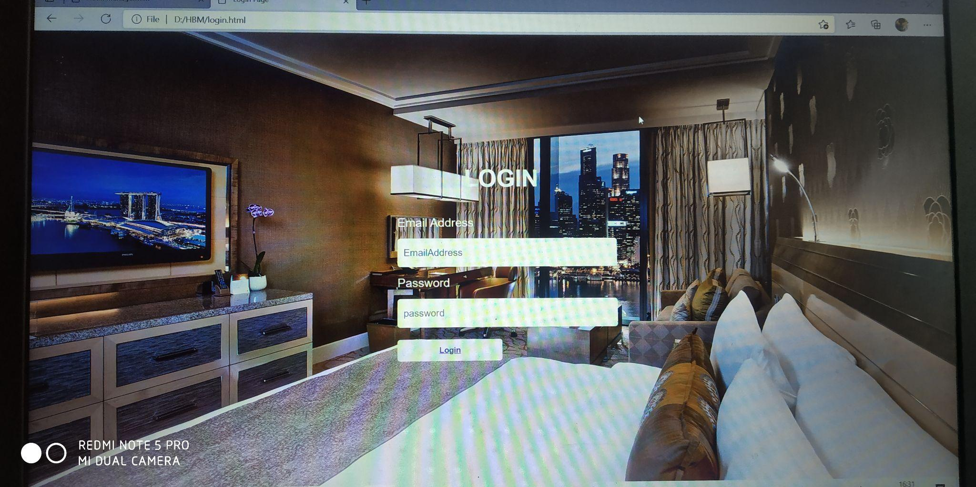
LOGIN SCREEN

Slide 7
SIGN UP
This module will help the tourist to register the credinals like name, email address and mobile number.
By signing up the tourist can see the details of the resort and visit the hotel to enjoy the vacation.

Slide 8
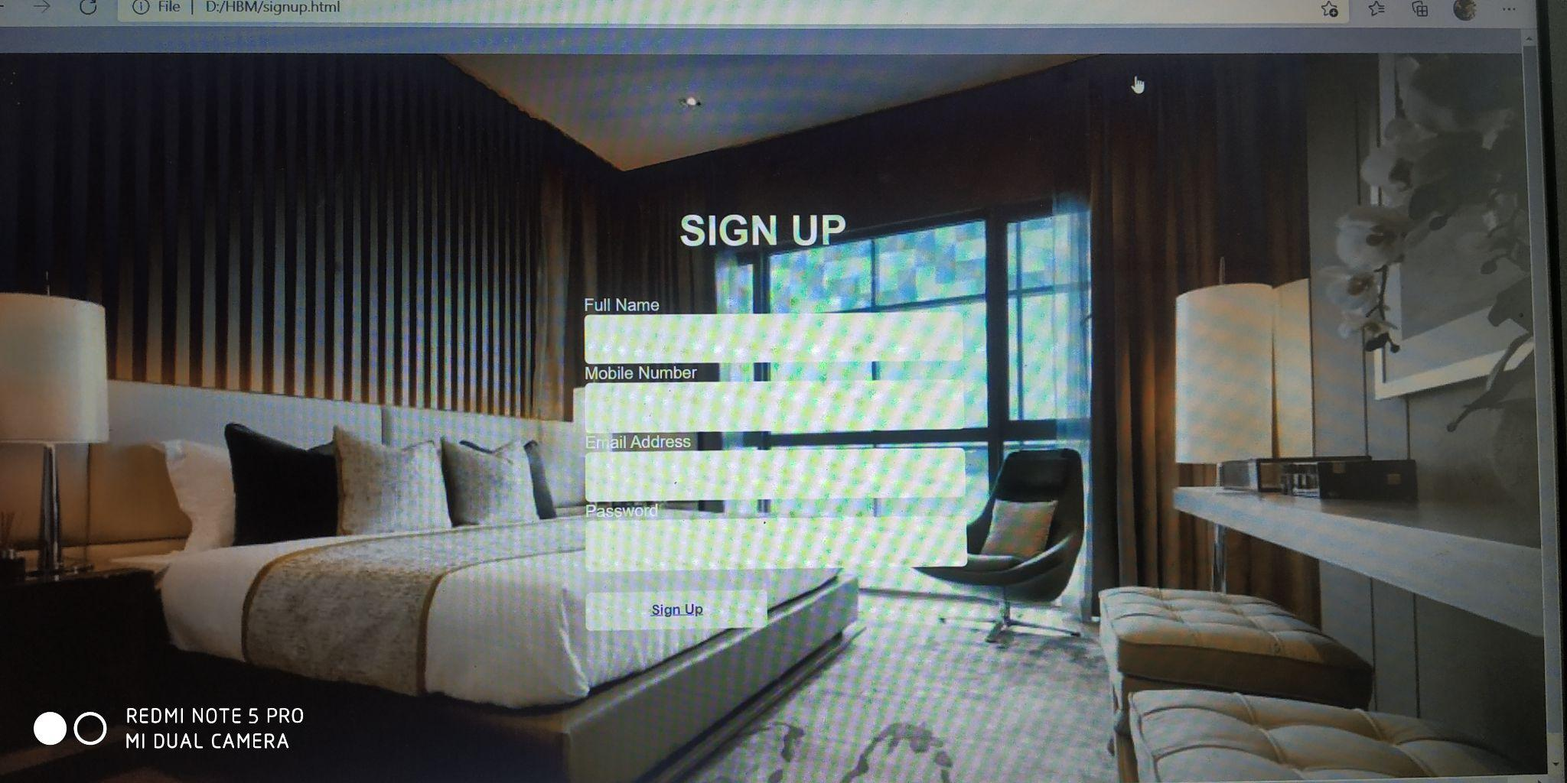
SIGN UP SCREEN

Slide 9
HOME PAGE
In this module we can find all the details regarding sign up, login, facilities in the resort, images of the rooms available and also the feed back for the tourist to give the opinion of the resort.

Slide 10
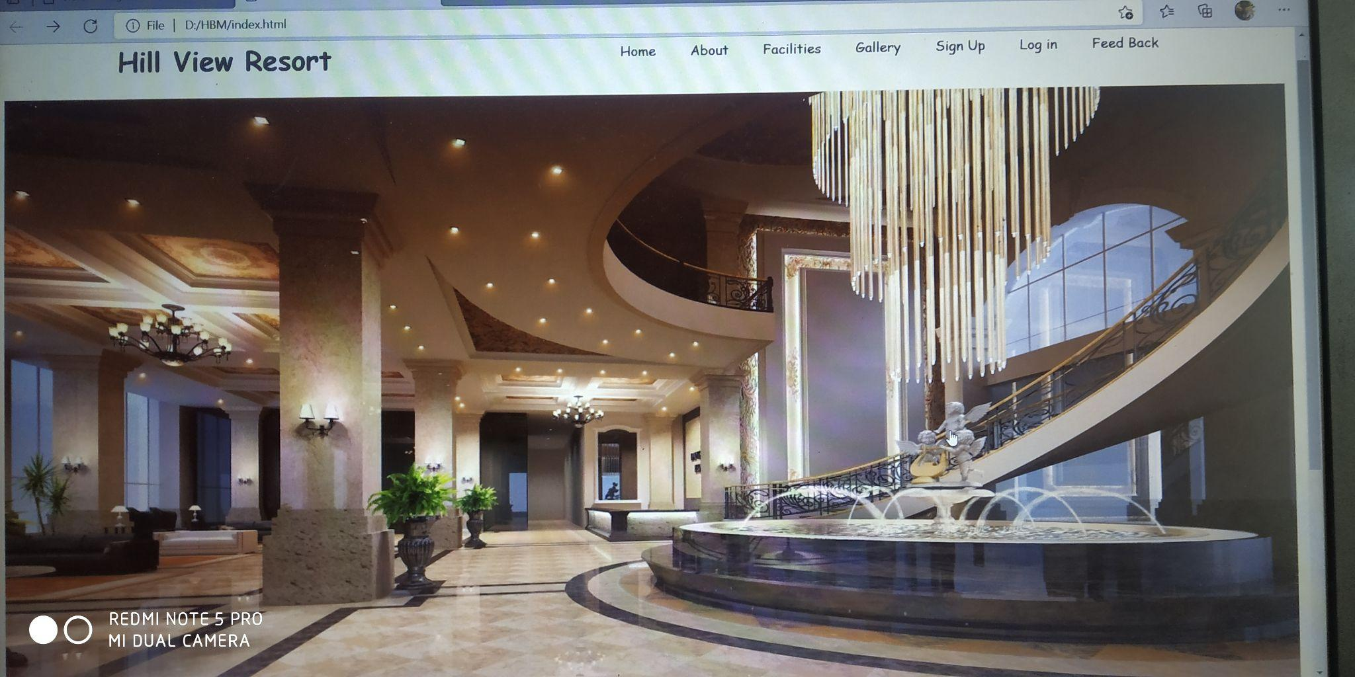
HOME PAGE SCREEN 1

Slide 11
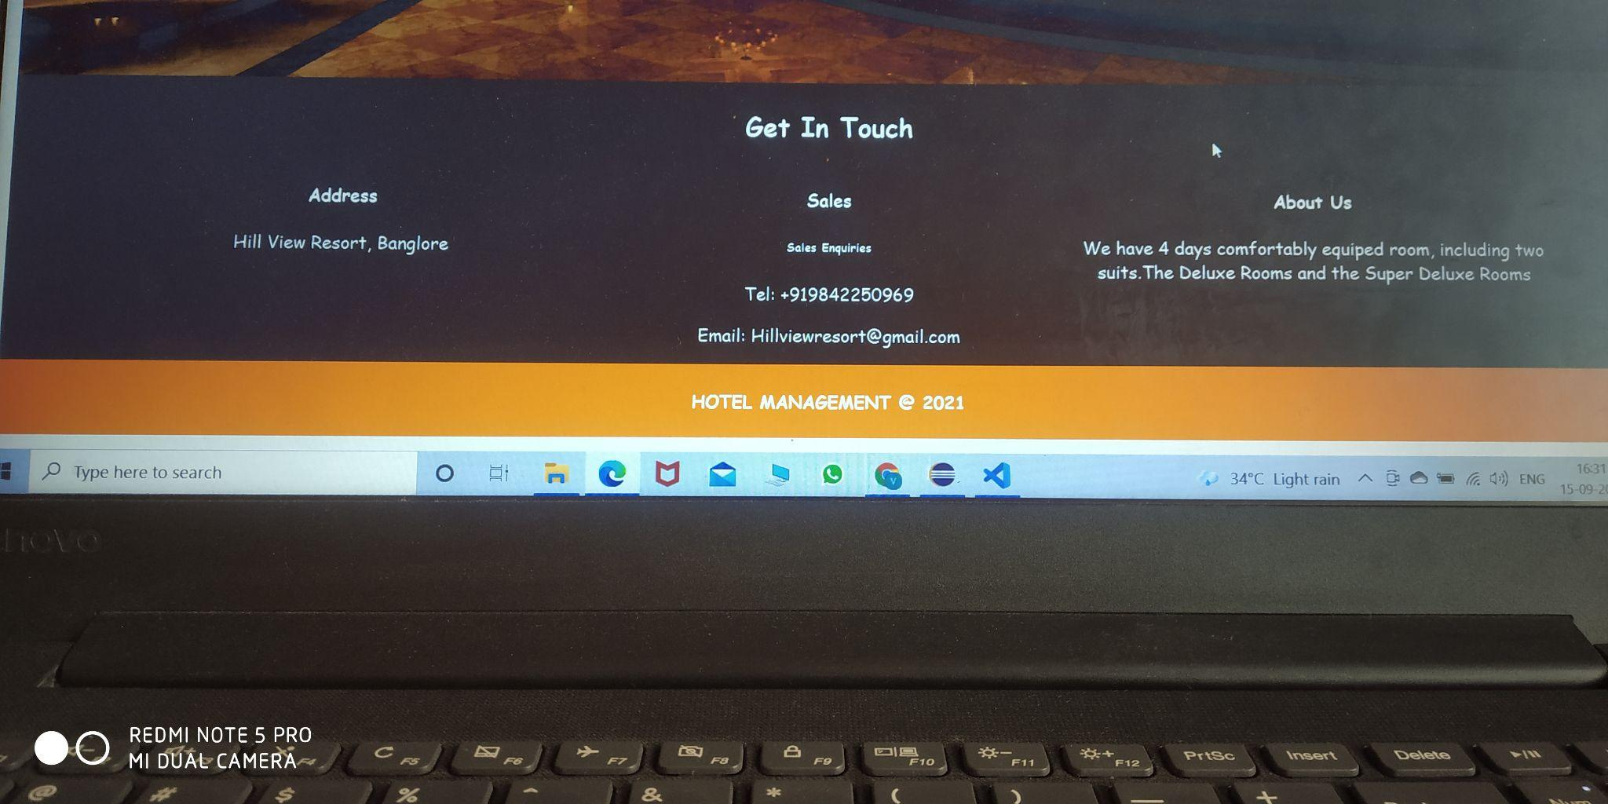
HOME PAGE SCREEN 2

Slide 12
ABOUT US
In this module, we can see the description of the resort which is very useful for the tourist to know about the hotel/resort.

Slide 13
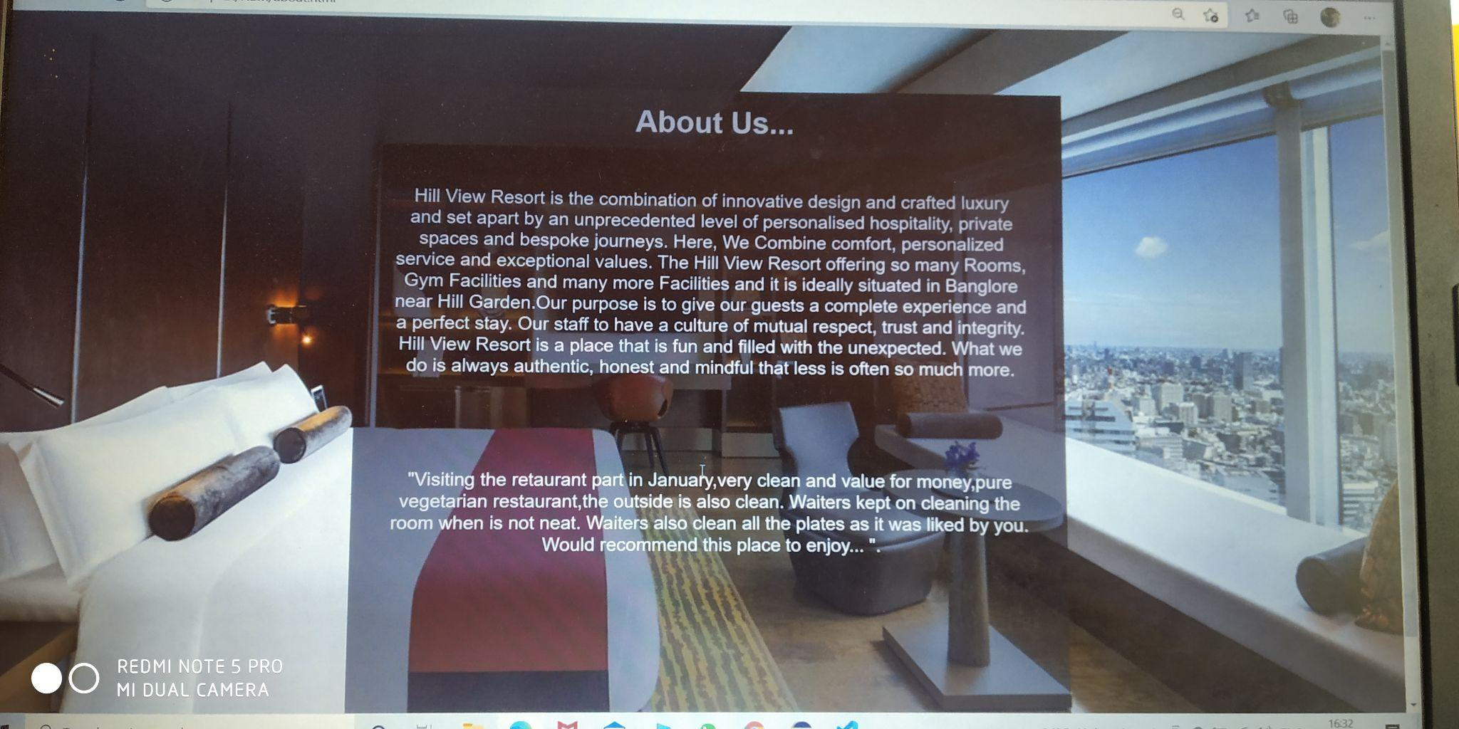
ABOUT US SCREEN

Slide 14
FACILITIES
In this module, we can see the facilities available in the resort such as free wifi, free transport for tours and excursions, baby sitting rooms available, laundry to wash the clothes, gym and spa facilities.

Slide 15
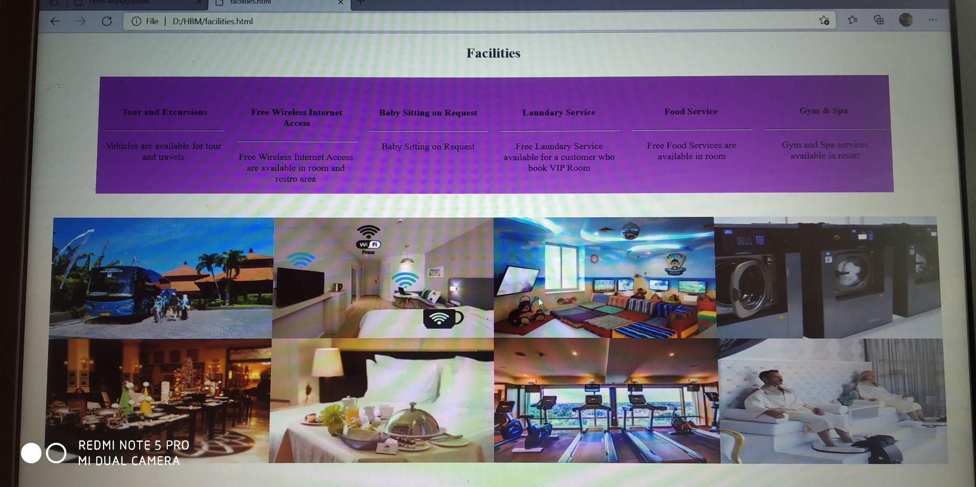
FACILITIES SCREEN

Slide 16
GALLERY
In this module, the images of the infrastructure of the resort, deluxe rooms and super deluxe rooms are available.

Slide 17
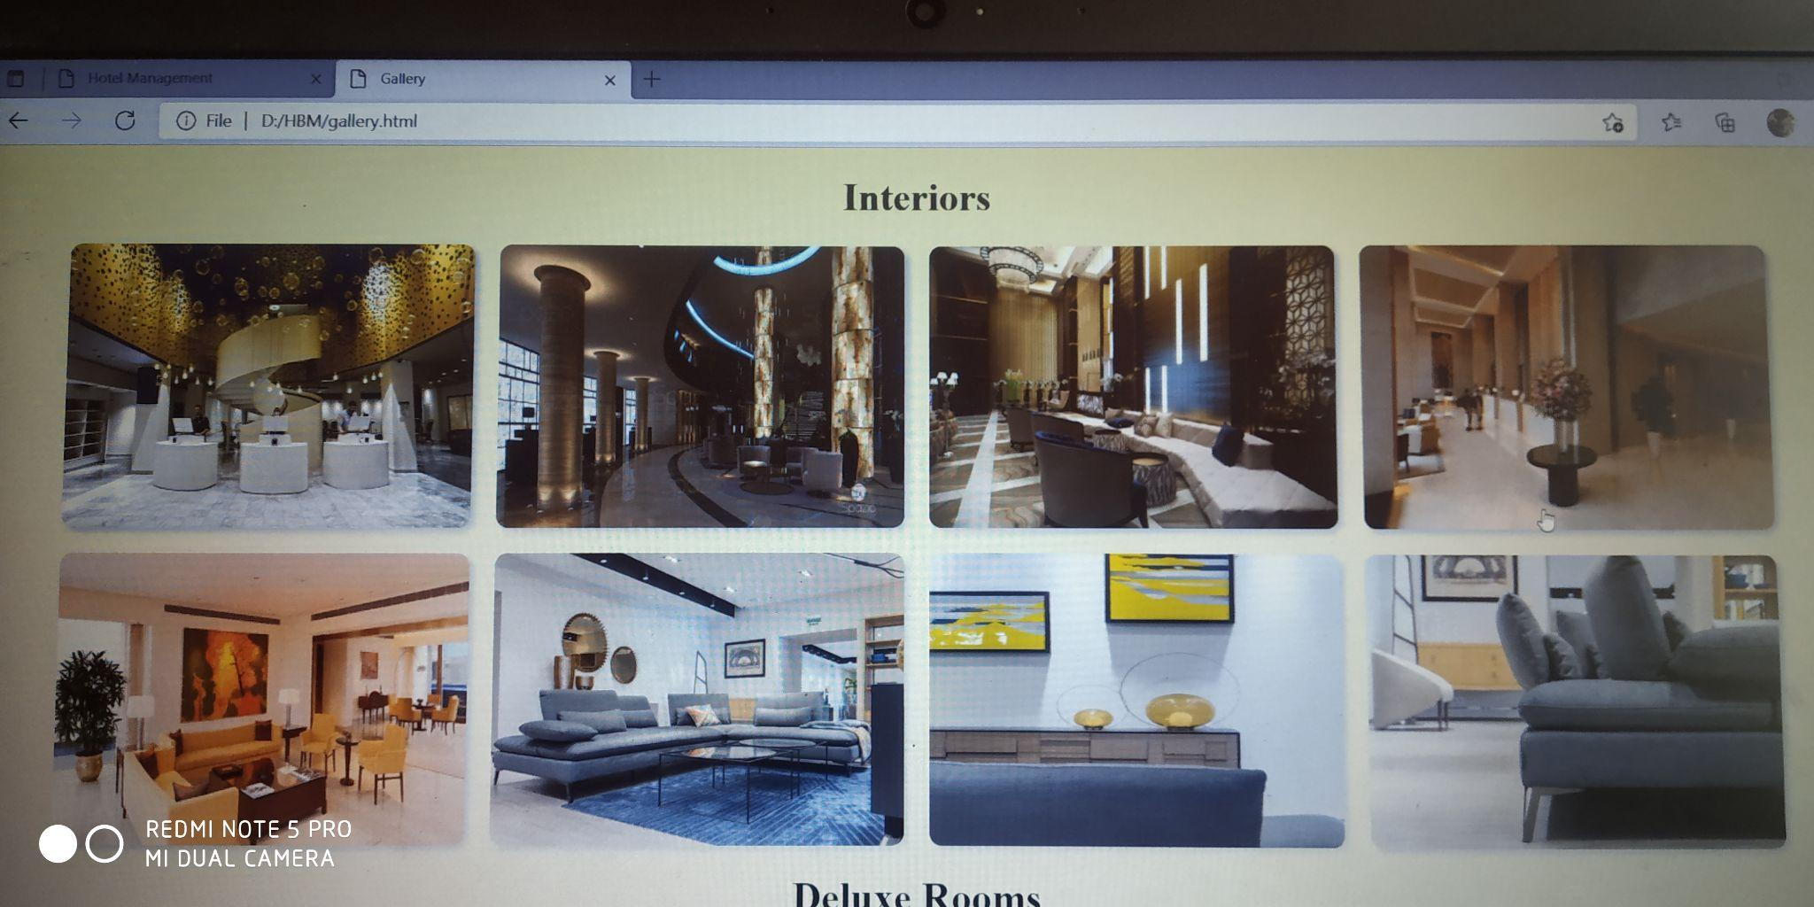
GALLERY SCREEN 1

Slide 18
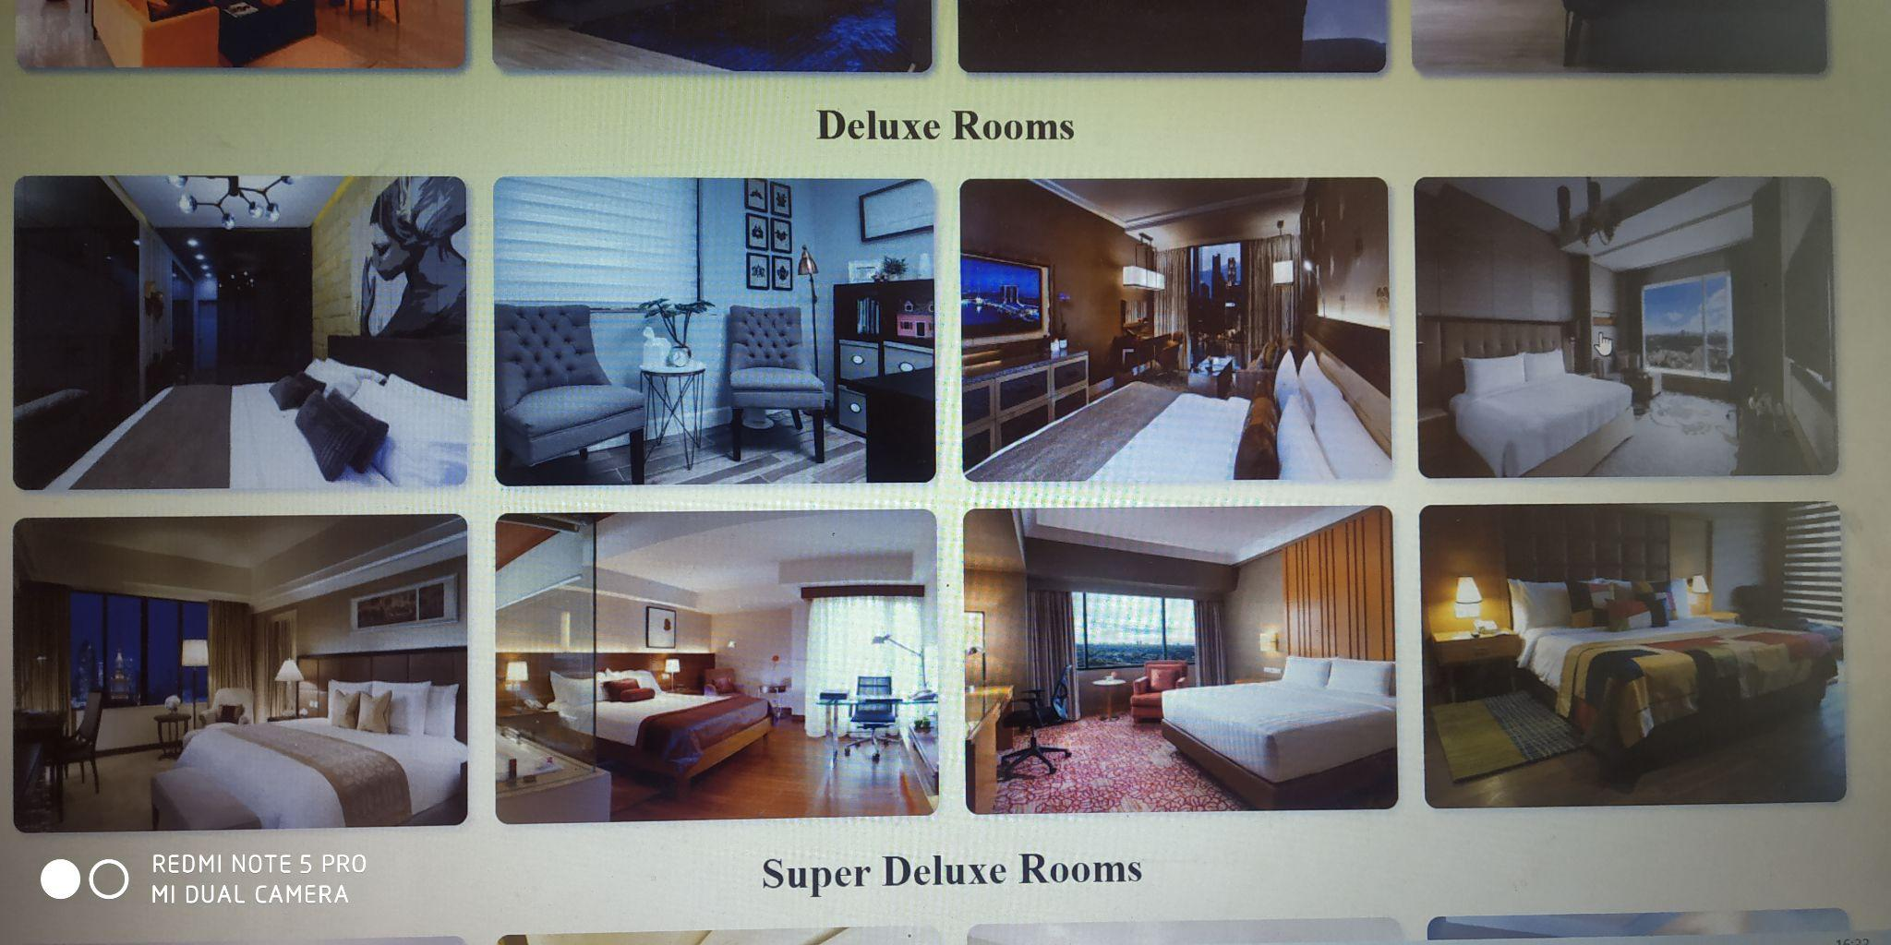
GALLERY SCREEN 2

Slide 19
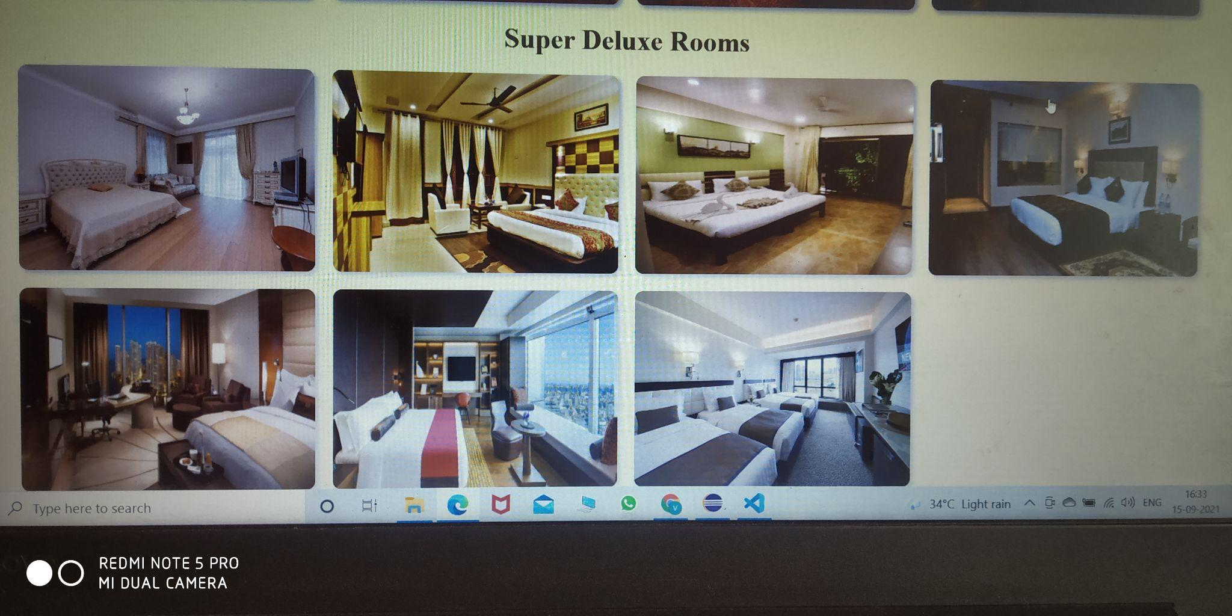
GALLERY SCREEN 3

Slide 20
FEED BACK
In this module, the tourist fills the feedback form and give comments and their opinions about the resort.
If the opinions are not satisfactory, the hotel management will be changed as per your likes.

Slide 21
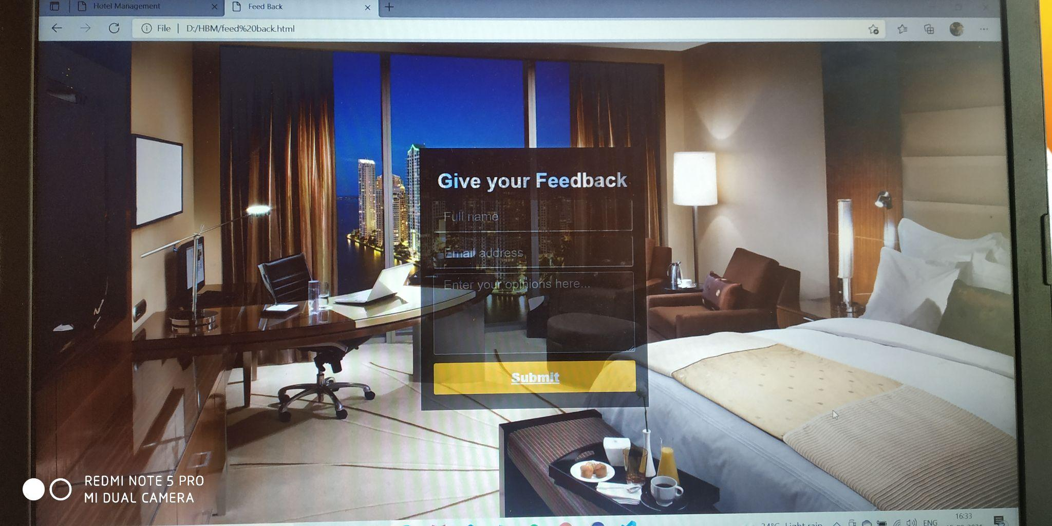
FEEDBACK SCREEN

Slide 22
ADVANTAGES
Easy access to the details of the resort.
Single solution for total Hotel Management System.
Cost efficient and user friendly.
Can know the full review of the resort clearly.

Slide 23
CONCLUSION
Hotel Management System can be used by the authorities to maintain the tourist records easily.
By achieving this objective we can register, login , see the facilities of the resort and the images of the views of the particular resort and give feedbacks about the resort.
This can be viewed by this project.

Slide 24
THANK YOU

